Slide 1

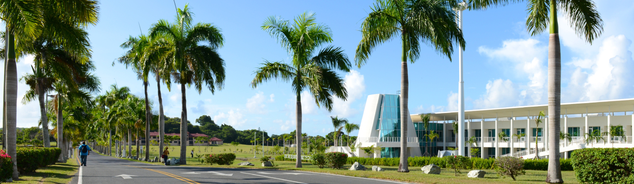


Artificial Intelligence in the Legal Arena:
Opportunities, Challenges, and Ethical Considerations
Dr. Ben C. Walter
Associate Professor of Mathematics
University of the Virgin Islands
Office of the Territorial Public Defender
December 12, 2024
https://bit.ly/49NUMjD

Slide 2
Artificial Intelligence
Artificial Intelligence
Artificial Intelligence (AI) - system which performs tasks usually requiring human intelligence
Machine Learning (ML) – system which learns patterns in data to make predictions without explicit instructions
Neural Networks – machine learning models inspired by neurons in brains consisting of interconnected nodes
Deep Learning – multi-layered neural networks with later / deeper layers capturing higher-order information
Generative AI – systems creating new output – text, images, or audio – as opposed to merely describing or classifying
Large Language Models (LLM) – deep learning networks trained on text data to understand / generate language
Machine Learning
Neural Network
Deep Learning
Generative AI
Large Language Model

Slide 3
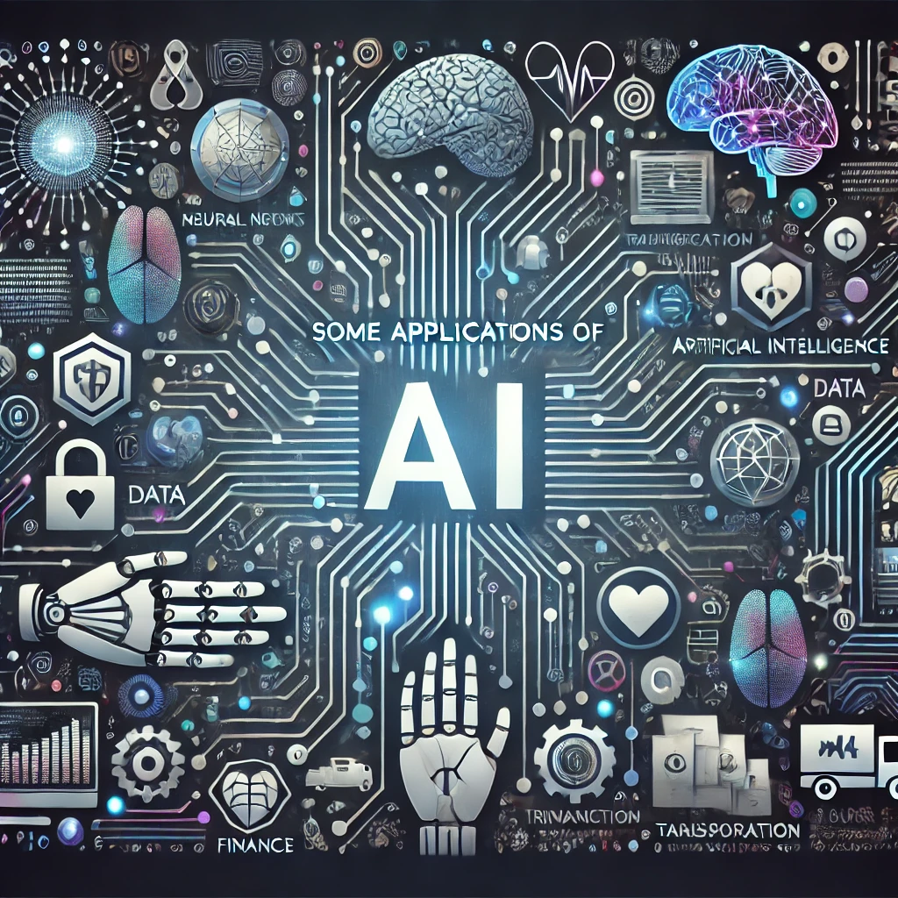
Some Applications of Artificial Intelligence
Self-driving cars
Smart home devices
Virtual assistants
Fraud detection
Chemical research
Customer service
Weather forecasting
Market prediction
Recommendation systems
Facial / object recognition
Sentiment analysis
Speech / language translation
Audio transcription (meeting / video captions)
Content summary
Content editing (text, computer code)
Content generation (text, images, video, audio, speech, code)
Content moderation (message boards, chats, online game interactions)
Personalized learning / tutoring
Help with teacher grading / feedback
Chatbot
Spam filtering
Network intrusion / virus detection
Sportscasting / commentating (e.g. Wimbledon)

Slide 4
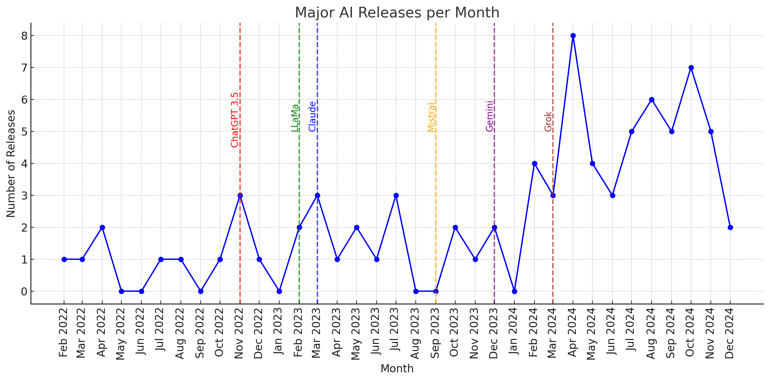
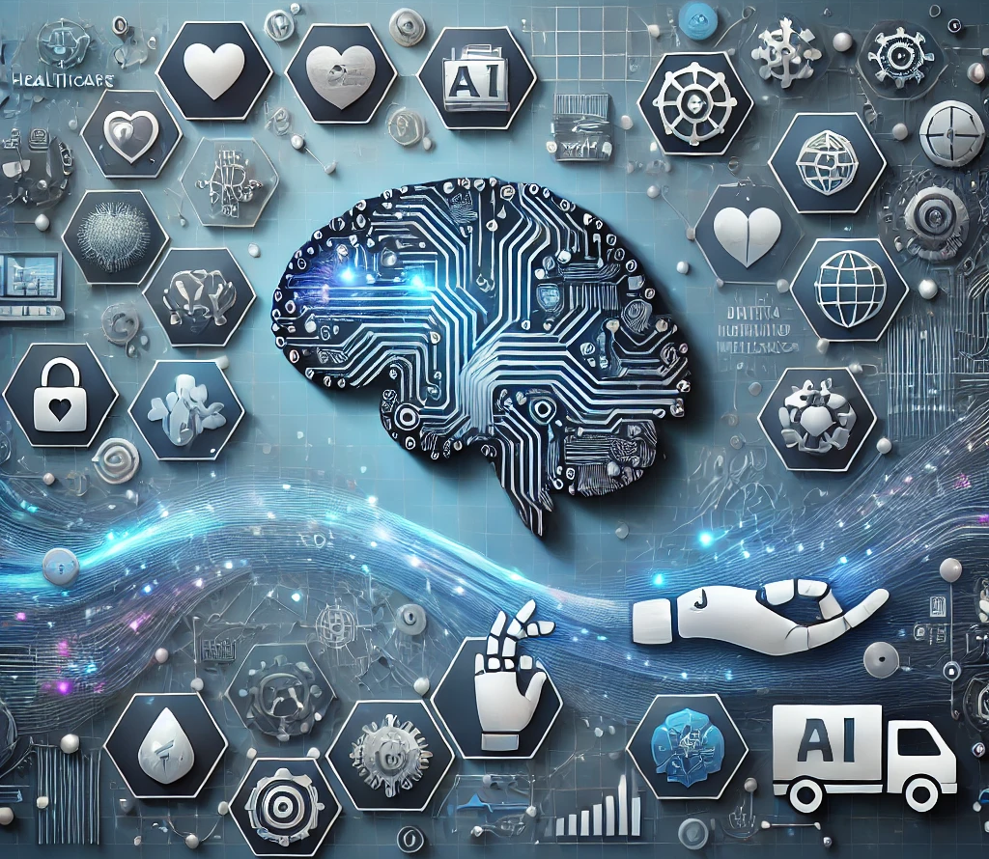
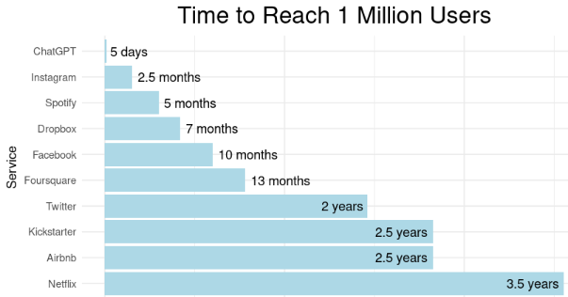
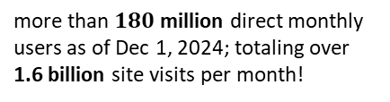

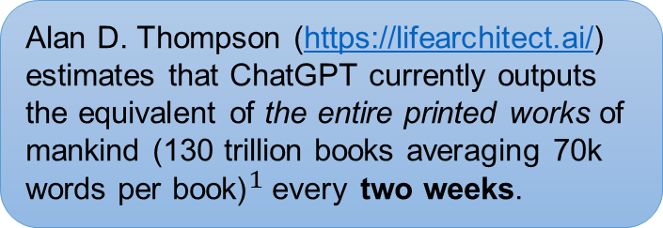
Growth of Generative Artificial Intelligence (Gen AI)
more than $180$ million direct monthly users as of Dec 1, 2024; totaling over 1.6 billion site visits per month!
Data from https://nhlocal.github.io/AiTimeline/
Alan D. Thompson (https://lifearchitect.ai/) estimates that ChatGPT currently outputs the equivalent of the entire printed works of mankind (130 trillion books averaging 70k words per book)${}_{ }^{1}$every two weeks.
$^{1}$Based on Google Books study

Slide 5







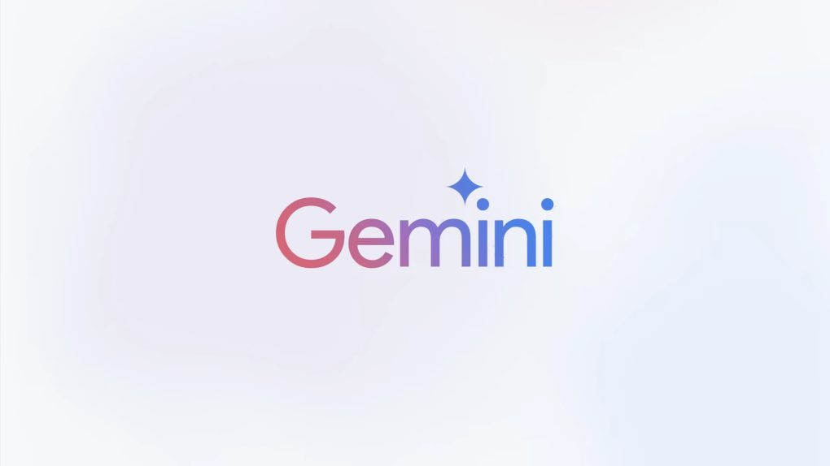


Major Gen AI Platforms
Dec 2024 AI rankings from
https://lmarena.ai/
Note: multimodal input / output and web search is now standard for major AI!
(OpenAI)
(Meta)
May 2024 GPT-4o - canvas (in beta) for collaboration - API used for many other AI apps
Dec 2024 o1 - “chain of thought” reasoning - advanced math / physics - slower! more expensive!
Dec 2024 LLaMa 3.3 - open source and “open weight” - code & weights used in many other AI’s - text-only input (text or image output) Meta AI - in Facebook, Messenger, Instagram, etc.
(Mistral AI) Emphasis on free / open-source models
(Anthropic)
Nov 2024 Mistral / Pixtral / Codestral / Mathstral - canvas interface (like GPT-4o Pro) - web search (with citations)
Oct 2024 3.5+ Sonnet - focus on ethics, alignment, safety - accuracy over creativity - does not train on user interactions - artifacts! agentic computer use!
- no web search / image generation
(01.AI)
Oct 2024 Yi-Lightning - most powerful Chinese AI
(Google)
Nexusflow
(Nexusﬂow Solution)
Sept 2024 1.5 Flash / Pro - targets research (partner with OpenStax) - web search (with citations) - integrated with Google ecosystem
Nov 2024 Athene-V2 - open source and “open weight”
(xAI)
Aug 2024 Grok 2 - creativity over accuracy

Slide 6


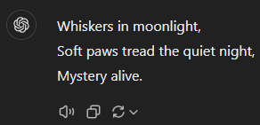
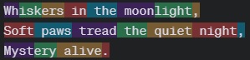
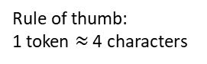
LOTS OF MULTIPLICATION
AND ADDITION
Outline of Generative AI Process
tokenizer
Output of https://platform.openai.com/tokenizer
Rule of thumb:
1 token $≈$ 4 characters
Prompt
Tokens (phrases, words, subwords)
embedding
Modern Generative AI’s use between 100,000 and 200,000 tokens!
Embedding size of GPT-3 was about 12,000 dimensions (numbers)
Similar tokens are assigned nearby numbers
Adding properties corresponds to addition of numbers
Semantic Vectors (numerical representation of meaning)
self-attention
Attention mechanism relates tokens to each other to find most relevant token (introduced by Google in 2017)
iterate
transformer layers
Feed-forward network multiplies vectors by weights and combines them
feedforward
Current top AI’s use over 1 trillion learned weights (parameters)
Next Token Prediction (list of possible tokens and probabilities – pick one)
Each transformer layer captures different features of the input word level → phrases → sentences → overall meaning
Current top AI’s use 80-100 layers with size around 8,000
Method used to choose next token affects “creativity” of the model.
de-tokenizer
Response
Generated Output

Slide 7


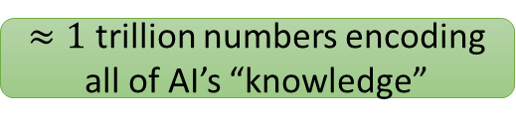
$≈1$ trillion numbers encoding all of AI’s “knowledge”
Training AI – Computing Weights
1 + 1 =
1 + 1 =
Use massive dataset: diverse and representative
Initialize model with random weights
Gradually update weights as follows.
Using part of data, run model to predict next token
Compare to actual next token
Adjust weights to make actual value more likely
Repeat multiple times over all data!
1 + 1 =
1 + 1 =
1 + 1 =
AI
AI
weights
AI
AI
weights
AI
weights
weights
weights
1 + 1 = red
1 + 1 = red
1 + 1 = red
1 + 1 = red
1 + 1 = red
Very expensive! ($≈\$100$ million; weeks or months of time; growing exponentially)
Fine Tuning
Additional training further modifying computed weights with new data
Less resource-intensive than full training
Risks “catastrophic forgetting”
Adapter-Based Tuning
Adding new layers onto network without changing existing weights
Very lightweight
Modifying
Models
Fast and inexpensive

Slide 8
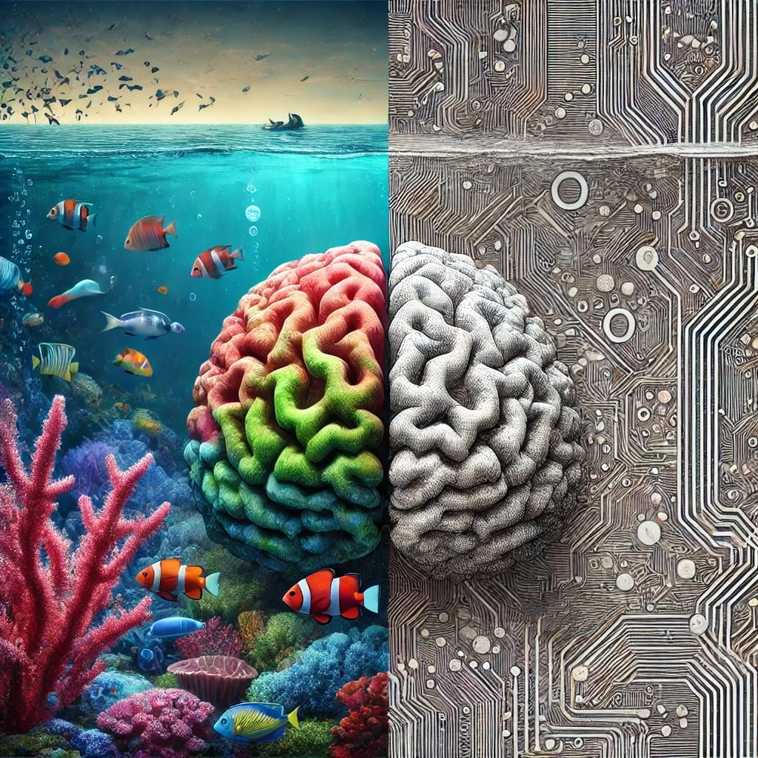

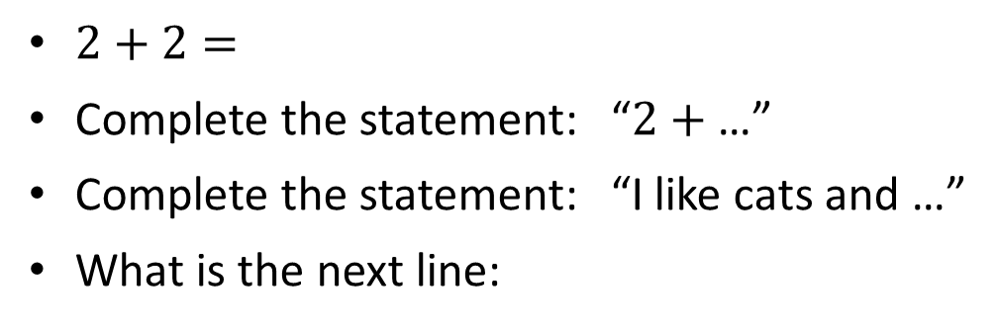
Summary
Generative AI works like a very fancy autocomplete
ChatGPT views the following prompts similarly:
$2+2=$
Complete the statement: “$2+$ …”
Complete the statement: “I like cats and …”
What is the next line:
AI are not “computers”
“Hey, I just met you, and this is crazy
But here’s my number …”
Creative rather than Computational
Random rather than Deterministic
Not “does exactly what you tell it”
Not “garbage in – garbage out”
So call me, maybe?

Slide 9
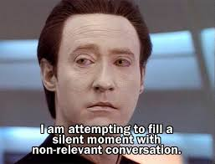
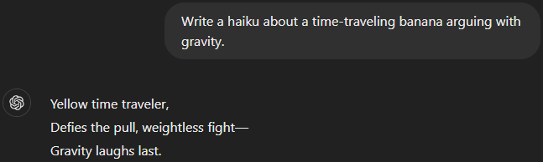
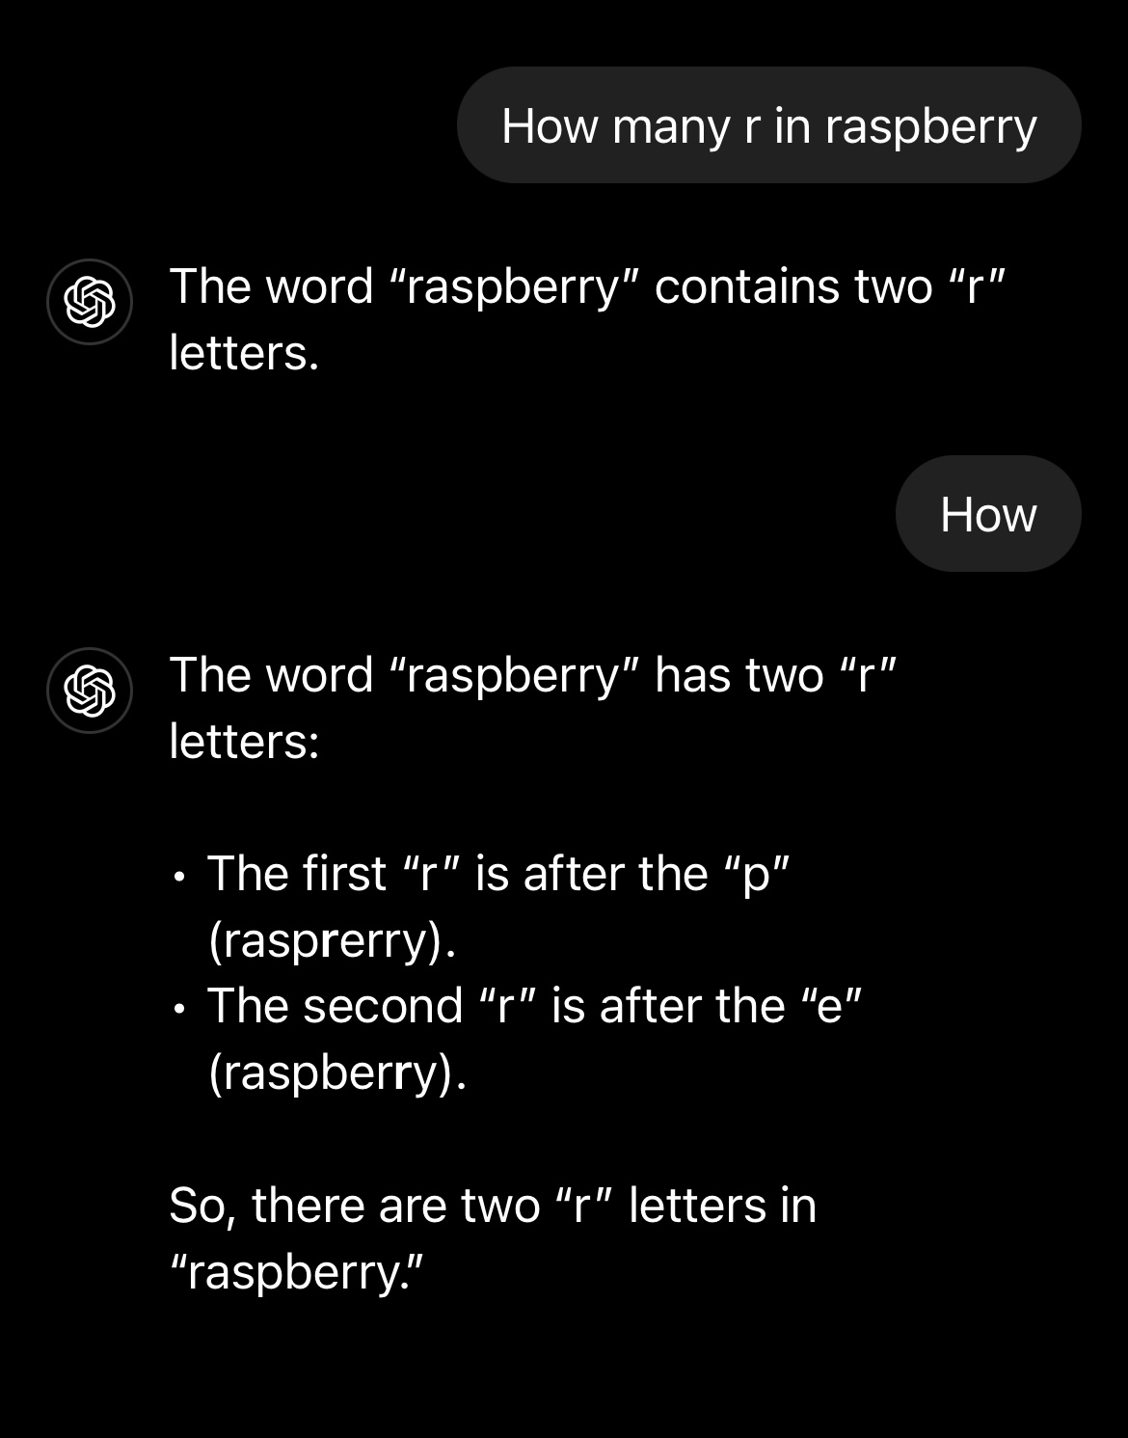
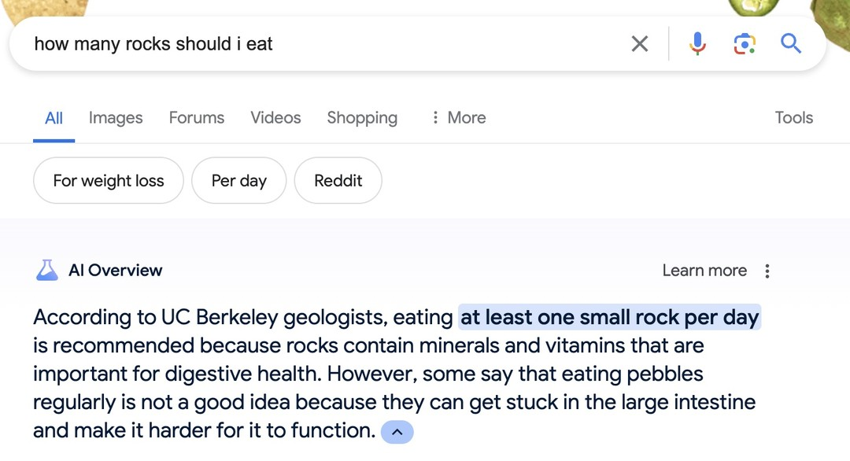

Expectations of AI vs Reality of AI
The AI we were told to expect…
The AI we were given…
Accurate,
Literal
ChatGPT, Dec 10, 2024
Star Trek: The Next Generation
Emotionless
OpenAI Developer’s forum, Aug 2024 “Incorrect count of ‘r’ characters…”
Google AI Overview (Gemeni), May 2024
I know now why you cry. But it is something I can never do.
Output may not always be accurate. You should not rely on Output from our Services as a sole source of truth or factual information, or as a substitute for professional advice.
You must evaluate Output for accuracy and appropriateness for your use case, including using human review as appropriate, before using or sharing Output from the Services.
- OpenAI terms of use
Terminator 2: Judgement Day

Slide 10
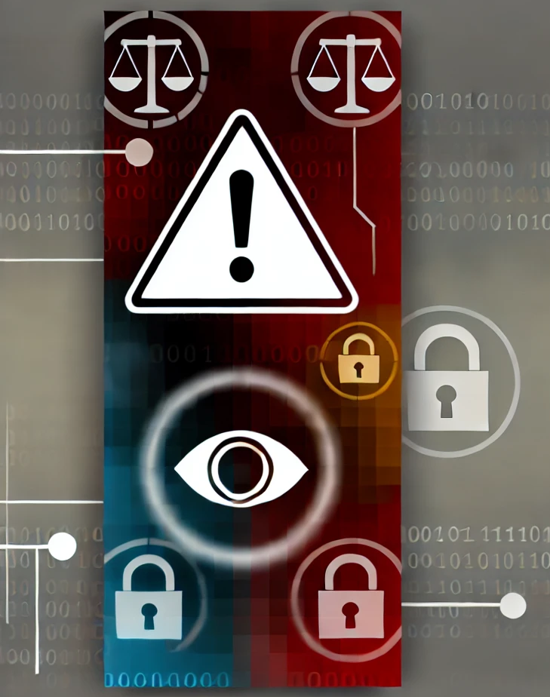
Some problems with artificial intelligences
Accuracy / Accountability. False output (i.e. “hallucinations”) – recommendation: “human-in-the-loop”
Privacy / Confidentiality. Prompts and attached data may be used for further training; various methods can expose training data (glitch tokens, overfitting)
Bias. Characteristics of training data will appear in output; implicit bias has been observed in AI outputs inferring ethnicity from names
Editorializing AI likes to construct a narrative

Slide 11
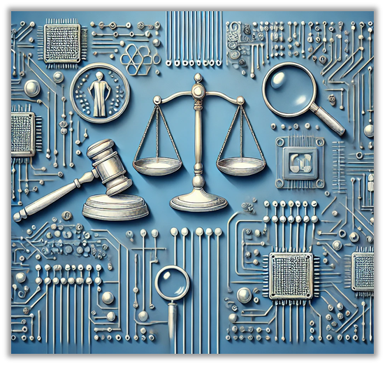
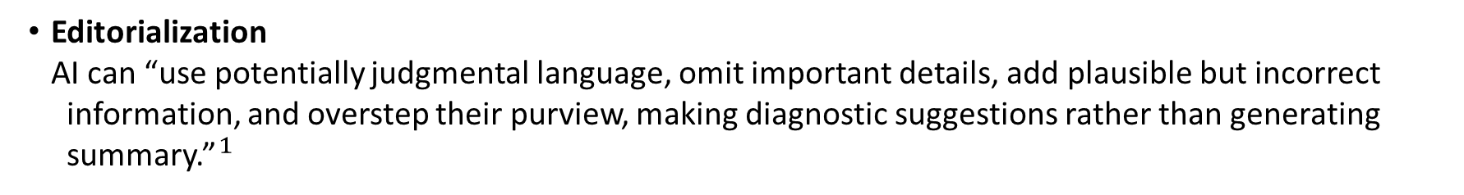
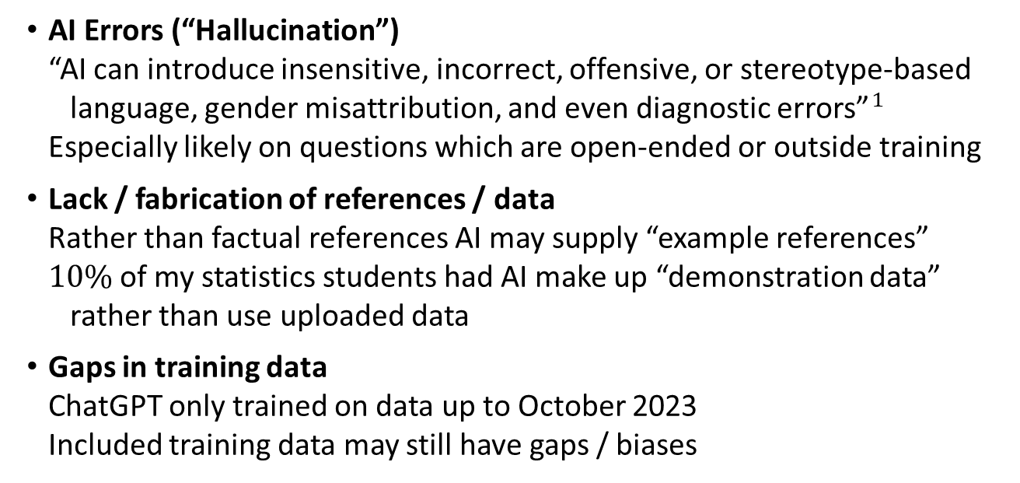
Accuracy / Accountability
AI Errors (“Hallucination”) “AI can introduce insensitive, incorrect, offensive, or stereotype-based language, gender misattribution, and even diagnostic errors”${}_{ }^{1}$ Especially likely on questions which are open-ended or outside training
Lack / fabrication of references / data Rather than factual references AI may supply “example references” $10\%$ of my statistics students had AI make up “demonstration data” rather than use uploaded data
Gaps in training data ChatGPT only trained on data up to October 2023 Included training data may still have gaps / biases
ChatGPT does not “consult it’s database” It does not “look up” any facts
AI output is all “hallucination” – but we only complain when it is wrong…
Editorialization AI can “use potentially judgmental language, omit important details, add plausible but incorrect information, and overstep their purview, making diagnostic suggestions rather than generating summary.”${}_{ }^{1}$
$_{ }^{1}$ Altschuler S, Huntington I, Antoniak M, Klein LF. Clinician as editor: notes in the era of AI scribes. Lancet. 2024

Slide 12

Privacy / Confidentiality
AI can be induced to leak training data. Massive training data sets can also be directly stolen or exposed via human intervention or mistakes.
Training data privacy Internal AI may be trained with confidential data; e.g. names, phone numbers, addresses, salary. Known attacks can extract this information. - see Nasr. Scalable extraction of training data… (2023)
Query data privacy Many AI will self-improve, training on supplied query or analysis data. Any non-anonymized data exposed to the AI is at risk of leakage.
See “Glitch tokens” https://arxiv.org/abs/2404.09894

Slide 13
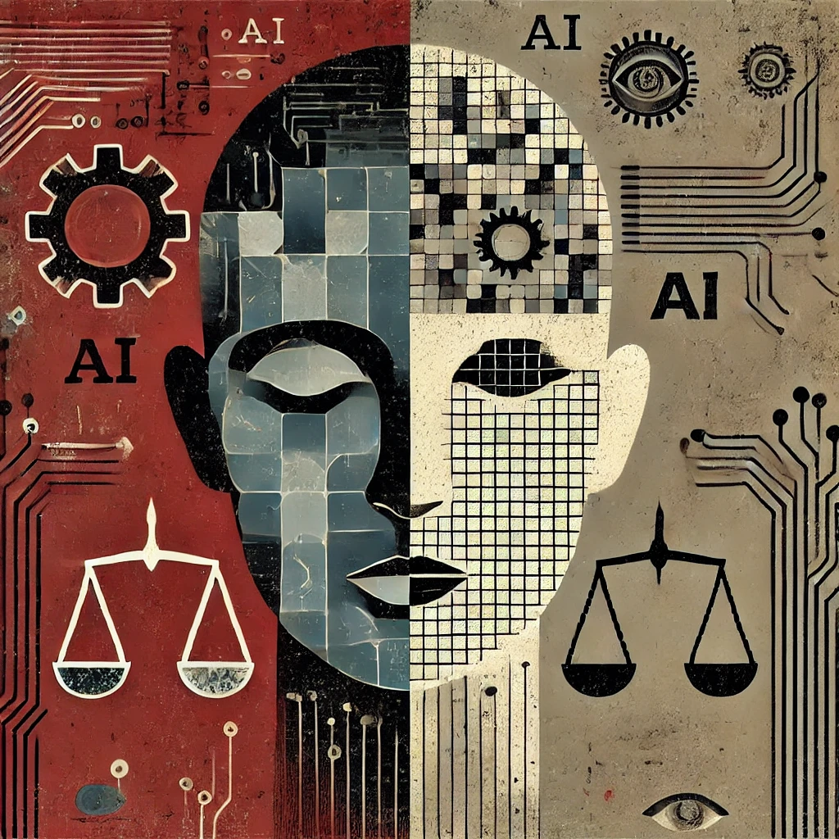
Bias
AI reflect any biases present in the data they are trained on, perpetuating existing inequalities. (Generated content is based on learned patterns.)
Bias in predictive / automatic decision making Predictive algorithms trained on historic data (e.g. historic crime data or cv’s of successful applicants) don’t account for changing demographics.
Bias in underrepresented language / dialect queries and responses Low prestige languages and dialects receive less informative responses. This perpetuates sociolinguistic inequality.
Discriminatory results from machine learning algorithms due to training data bias E.g. facial recognition prone to errors on darker skin tones yielding discriminatory outcomes; medical algorithms less effective on underrepresented groups yielding poor diagnoses; image generation reflecting training bias.
Identity bias AI have been shown to give biased responses based on racial / gender identities inferred only from names

Slide 14
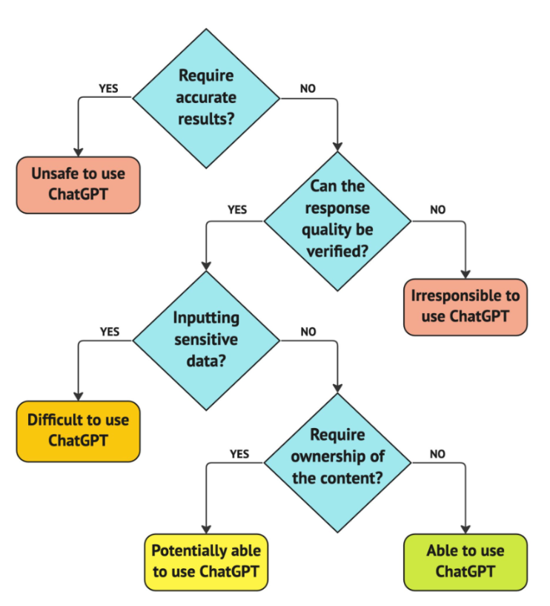
When is ChatGPT Appropriate?
You are here.
Or here.
Or here.
Flowchart source: DataCamp. Introduction to ChatGPT, Ch 2 Adopting ChatGPT

Slide 15
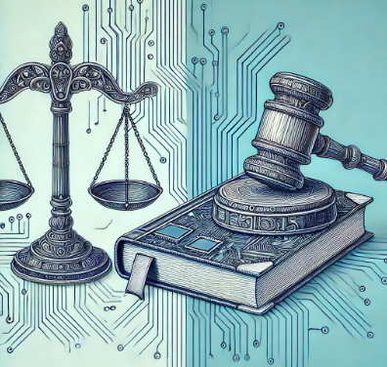
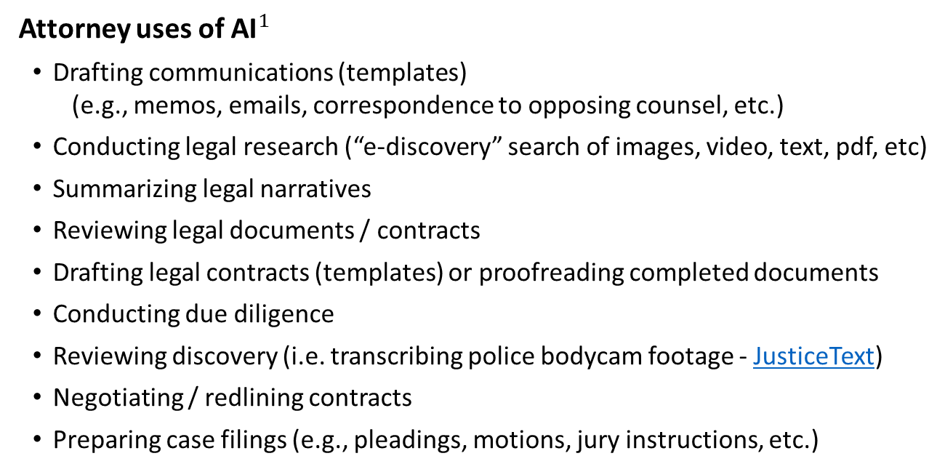
VI Consortium. July 17, 2004 reports that OTPD has 1,020 open cases “current case load exceeds reasonable capacity for effective representation”
AI for Attorneys
Attorney uses of AI${}_{ }^{1}$
Drafting communications (templates) (e.g., memos, emails, correspondence to opposing counsel, etc.)
Conducting legal research (“e-discovery” search of images, video, text, pdf, etc)
Summarizing legal narratives
Reviewing legal documents / contracts
Drafting legal contracts (templates) or proofreading completed documents
Conducting due diligence
Reviewing discovery (i.e. transcribing police bodycam footage - JusticeText)
Negotiating / redlining contracts
Preparing case filings (e.g., pleadings, motions, jury instructions, etc.)
Top AI Tools Specifically for Attorneys (by market value):
Harvey AI https://www.harvey.ai Backed by OpenAI
Robin AI https://www.robinai.com Based on Anthropic Claude
Clio Manage / Duo https://www.clio.com Built on Microsoft Azure / OpenAI
Thomson Reuters Casetext / CoCounsel
Also many legal AI tools targeting public
i.e. Genie AI https://www.genieai.co/
Unauthorized practice of law????
$_{ }^{1}$ https://pro.bloomberglaw.com/insights/technology/ai-in-legal-practice-explained

Slide 16
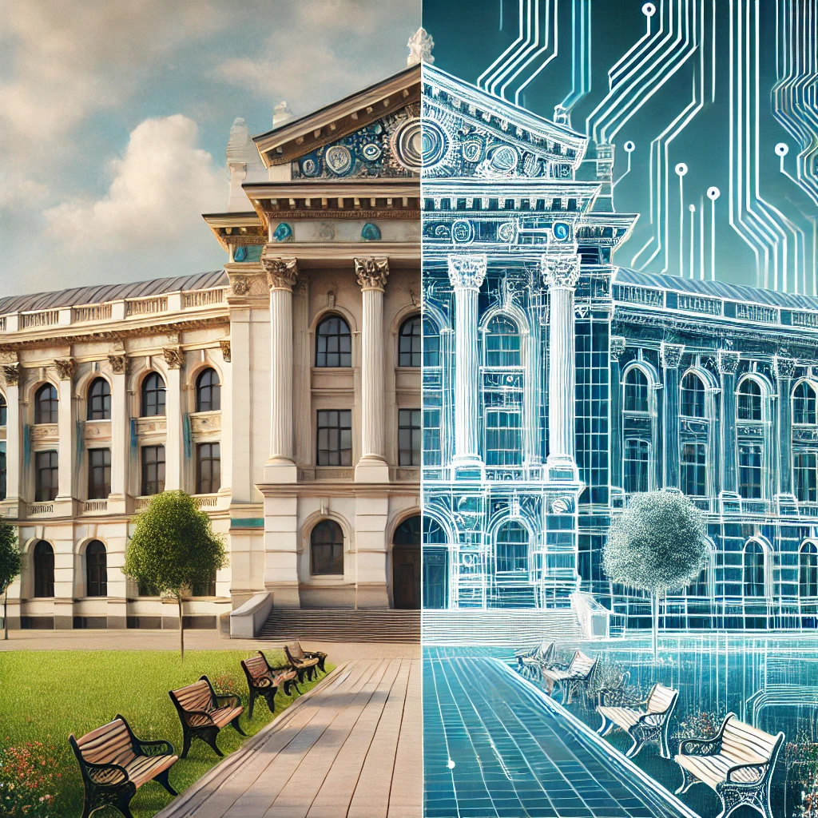
AI in the Courtroom
AI companies also offer solutions tailored to court systems
Transcription Robust voice transcription AI can supplement court reporters Especially useful in cases of interruptions / overtalking Can also give searchable transcripts of audio / video evidence (see For The Record https://fortherecord.com)
Translation (Speech-to-Speech) AI translation can remove obstacles in court proceedings
Text-to-Speech AI services can read documents for the illiterate or blind
Note: AI transcript is linked to audio recording which is official record
Auto-Docketing (especially for e-filed documents) AI is good for tedious mechanical tasks (Palm Beach County, FL; Terrant County, TX)
Judicial Guidance AI providers pushing to give first pass evaluation of briefs and aid in research (e.g. Clio Casetext) Machine learning tools have long been pushing to give bail and parole recommendations...
Public Inquiry Chatbot New Jersey, JIA chatbot (80% accuracy?); also Arizona, New Mexico
https://www.ncsc.org/__data/assets/pdf_file/0032/97187/Court-Chatbots.pdf

Slide 17
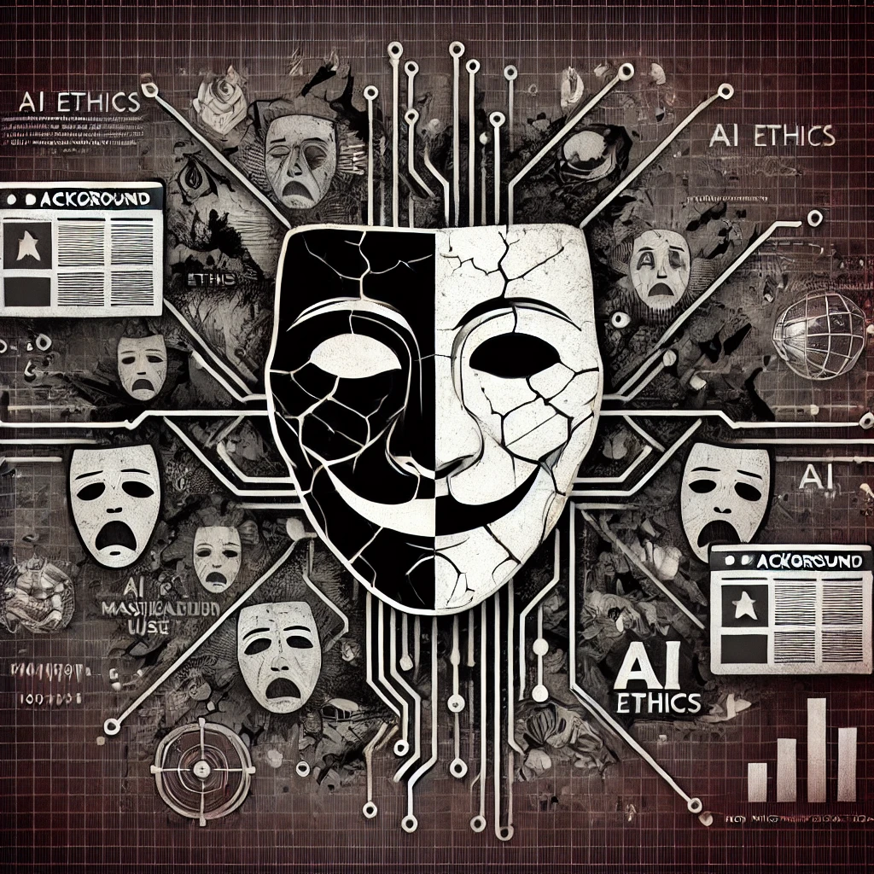
AI in Crime / Fraud
Deepfake pictures / audio / videos Blackmail, impersonation, simulated ransom, nonconsensual pornography
Targeted phishing attacks
Automated hacking attacks
Child pornography image generation
Forgery / Copyright violation see Etsy, Virtual influencers
Fraudulent reviews see FTC complaint vs. Rytr
“Algorithmic collusion” AI driven house price suggestions accused of price-fixing.
AI “Snake Oil” Scams Fraudulent “AI business opportunity” / “guaranteed income from AI” schemes see Ascend, Ecommerce Empire Builders, FBA Machine, and many others….

Slide 18
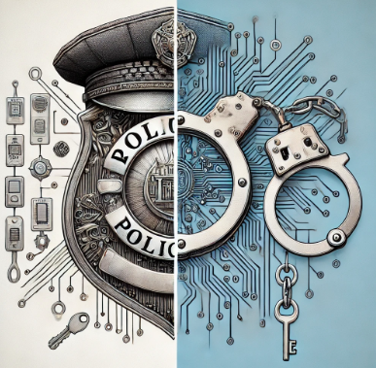
AI in Policing
Many police technology companies / startups are pitching AI applications
Integrated surveillance Data from cameras, license plate readers, radiological sensors, and drones gathered and linked by AI for search and alerts (e.g. Axon, Flock) See also New York Police Department’s Domain Awareness System
Predictive policing Automated response / directives based on integrated surveillance / historical data; shown multiple times to be biased and discriminatory
Police self-review Automated interaction / incident clipping /compilation from police bodycam footage (e.g. Truleo “police officer asst”)
Auto-generation of police reports [“drafts”] Generates police reports for incidents from police body camera footage (e.g. Axon’s Draft One service) Likely serious issues with hallucination, editorialization, bias, loss of independent narrative, corrupting / influencing officer memory / impression of incident (similar to showing an eye-witness captured video before interviewing)
“… the way US police are adopting AI is inherently chaotic… The police-tech companies that serve them will build the tools police departments find attractive.”
-- MIT Technology Review. Nov 19, 2024

Slide 19
American Bar Association Formal Opinion 512
Standing Committee on Ethics and Professional Responsibility. July 29, 2024
AI vs ABA Model Rules of Professional Conduct
Competence.
Lawyers should have reasonable understanding of capabilities and risks of generative AI
Uncritical reliance on generative AI output without verification violates duty of competent representation
Confidentiality.
Lawyers must protect client information when using generative AI tools (be wary of sharing data with AI)
A client’s informed consent must be obtained before inputting information related to client into AI tool
Communication.
Clients should be informed about use of AI if output influences a significant decision in representation (similar to disclosing involvement of temporary lawyers making significant contributions)
https://www.americanbar.org/content/dam/aba/administrative/professional_responsibility/ethics-opinions/aba-formal-opinion-512.pdf

Slide 20
American Bar Association Formal Opinion 512
Standing Committee on Ethics and Professional Responsibility. July 29, 2024
AI vs ABA Model Rules of Professional Conduct
Meritorious Claims, Candor, Court Responsibilities.
Lawyers must verify that AI outputs (especially legal citations and analyses) are accurate and do not mislead courts
Lawyers should be prepared to explain to courts how they used AI, sources of information, and level of review
Supervisory Duties.
Legal professionals must ensure proper use of generative AI tools by subordinates and nonlawyers to ensure compliance with guidelines on competence and confidentiality
Fees.
Fees for generative AI assisted work must be reasonable and reflect actual time spent or direct costs incurred
Overcharging clients for efficiencies gained through generative AI use violates ethical rules
https://www.americanbar.org/content/dam/aba/administrative/professional_responsibility/ethics-opinions/aba-formal-opinion-512.pdf

Slide 21
Some references / Further reading
https://www.americanbar.org/content/dam/aba/administrative/professional_responsibility/ethics-opinions/aba-formal-opinion-512.pdf
https://www.ibanet.org/PPID/Constituent/Multi-displry_Pract/anlbs-ai-report
https://www.ncsc.org/__data/assets/pdf_file/0027/98910/JTC-AI-paper-update-3.5.24.pdf
https://news.bloomberglaw.com/us-law-week/courts-remain-skeptical-of-lawyers-use-of-chatgpt-in-litigation
https://www.clio.com/resources/ai-for-lawyers/
https://www.americanbar.org/groups/law_practice/resources/law-technology-today/2024/ai-tools-for-legal-work-claude-gemini-copilot-and-more/
https://www.technologyreview.com/2024/11/19/1106979/how-the-largest-gathering-of-us-police-chiefs-is-talking-about-ai/
https://www.technologyreview.com/2024/04/16/1090846/ai-police-body-cams-cops-transparency/
https://www.eff.org/deeplinks/2023/12/artificial-intelligence-and-policing-year-review-2023
https://a16z.com/navigating-the-high-cost-of-ai-compute/
https://www.prc.nm.gov/wp-content/uploads/2024/11/5-AI-in-Litigation-CLE-Final.pdf
https://mindmatters.ai/2023/04/20-ways-ai-enables-criminals/
https://www.ftc.gov/news-events/news/press-releases/2024/09/ftc-announces-crackdown-deceptive-ai-claims-schemes
Altschuler S, Huntington I, Antoniak M, Klein LF. Clinician as editor: notes in the era of AI scribes. Lancet. 2024 Nov 30;404(10468):2154-2155.
Nasr, M., Carlini, N., Hayase, J., Jagielski, M., Cooper, A. F., Ippolito, D., ... & Lee, K. (2023). Scalable extraction of training data from (production) language models. arXiv preprint arXiv:2311.17035.

